Slide 1
Programmer deanonymization using code stylometry
Student name: YASIN SAZID (BSSE 1006)
Supervised by: Prof. Dr. Kazi Muheymin-Us-Sakib
Course code: SE 305

Slide 2

Programmer deanonymization
Why deanonymize programmers?
Software Forensics
Detecting Plagiarism
Verification of authorship
Copyright investigation
Surveilence and tracking programmers

Slide 3
Approach
Codes of BSSE first year (training data)
Extract features
Profiles of programmers
Anonymous code
Extract features
Temporary profile

Slide 4
Approach
Profiles of programmers
Temporary profile
Programmer deanonymization
Matching using statistical measures

Slide 5
Components
Three major components
Feature analyzers
Statistical procedures
Profile management

Slide 6
Feature set
Bracing style
Percentage of proper indentation
Rate of white space in function or loop signatures
Space after/before certain symbol (equal ‘=’ symbol)
Total white space percentage
Total empty lines percentage

Slide 7
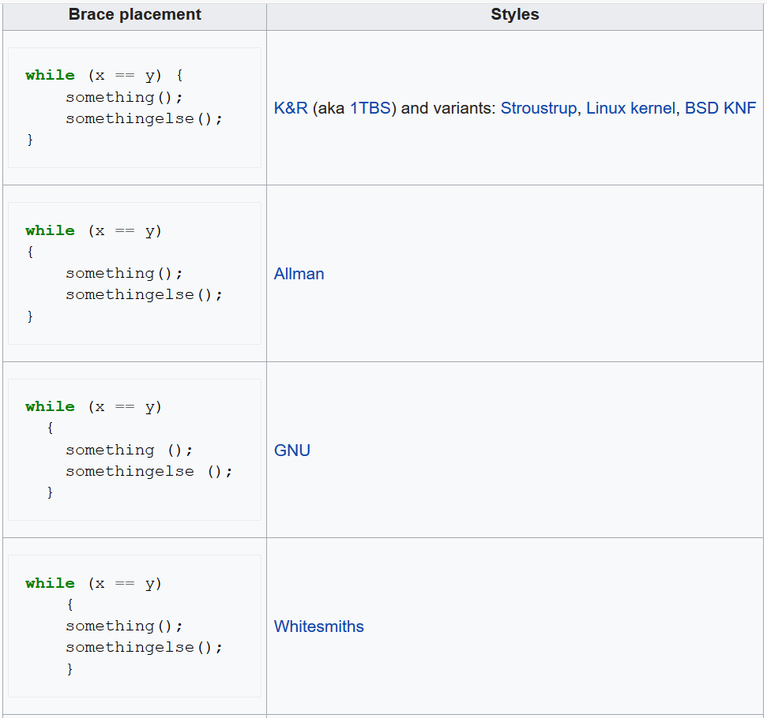
Bracing
Bracing
Styles

Slide 8
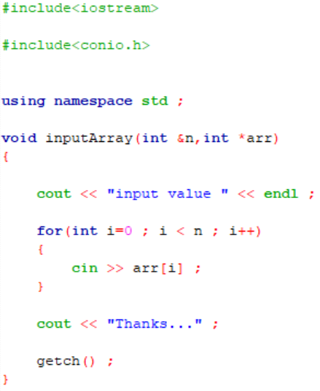
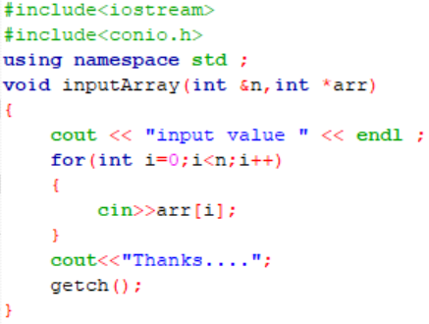
Spacing

Slide 9

Spacing
8 spaces
3 spaces

Slide 10
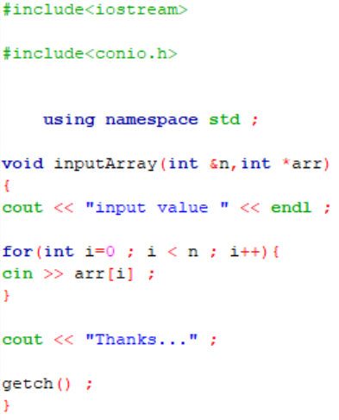
Indentation
Properly indented
Not properly indented

Slide 11
Deanonymization
Statistical measures
Distributional properties of data
Beta distribution
Normal distribution
Ranking technique
Naïve-Bayes
K Means clustering algorithm
Direct reasoning

Slide 12
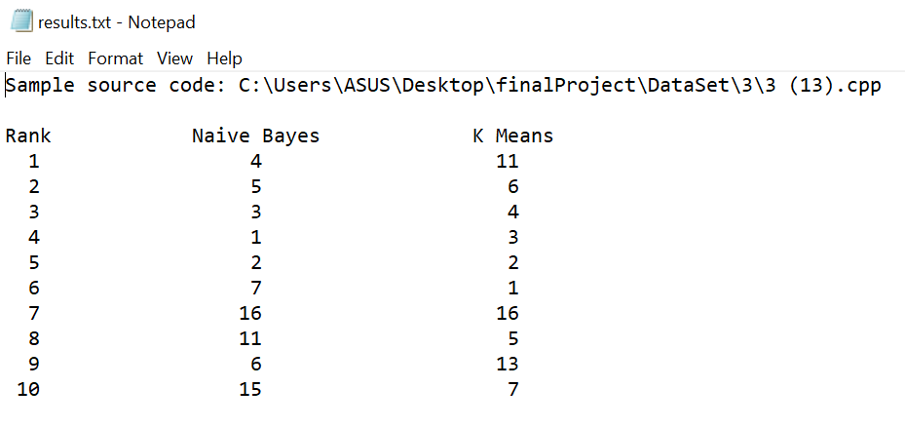
Output presentation

Slide 13
New Learnings
String manipulation
Using user defined headers
Working with multiple source files
Modularization
Statistical learning (normal and beta distribution)
Entering the realms of Machine Learning
Naïve-Bayes classifier
K Means clustering algorithm

Slide 14
Code
Github repository link:
https://github.com/bsse1006/SPL-1

Slide 15


